Slide 1
Behavioral Patterns
Chain of Responsibility
Mediator

Slide 2
Decouple sender and handler
Observer
Command
mediator
Chain of Responsibility

Slide 3
Chain of Responsibility
When you want to give more than one object a chance to handle a request
Example scenario: Email sorter
There are 3 types of incoming emails: spam, complaint, request.
Each will be put into a proper directory.
  Assume there is a detector that can tell the email category.
Create a design that can use the detectors to sort the incoming emails

Slide 4
Attempt 1:
public class Inbox{
public void receivedEmail(Email e){
if (detector.isSpam(e)){
//code to move to spam folder
}else if(detector.isRequest(e){
// move to request folder
}else if (detector.isComplaint(e ){
//move to complaint folder
} else {}
//do nothing leave at inbox
}
…
}
Ugly
Problems?
  OCP
  Lack of cohesion
  Single responsibility

Slide 5
Attempt 2: Single responsibility
public class Inbox{
private SpamFilter sf;
private RequestFilter rf;
private ComplaintFilter cf;
….
public void receivedEmail(Email e){
if (detector.isSpam(e)){
sf.sort(e);
}else if(detector.isRequest(e){
rf.sort(e );
}else if (detector.isComplaint(e ){
cf.sort (e );
} else { }//do nothing leave at inbox
}
}
public class SpamFilter{
public void sort(Email e){
if (detector.isSpam()){
//code to save it to spam folder
}
}}
public class RequestFilter{
public void sort(Email e){
if (detector.isRequest()){
//code to save it to request folder
}
}}
public class ComplaintFilter{…}
Problems?

Slide 6
Attempt 2: Single responsibility
public class Inbox{
private SpamFilter sf;
private RequestFilter rf;
private ComplaintFilter cf;
….
public void receivedEmail(Email e){
if (detector.isSpam(e)){
sf.sort(e);
}else if(detector.isRequest(e){
rf.sort(e );
}else if (detector.isComplaint(e ){
cf.sort (e );
} else { }//do nothing leave at inbox
}
}
Problems:
High coupling
OCP?
  Extend with new filters
  Change the filtering order

Slide 7
Example: Email sorter
We want to give the Spam, Complaint, and Request filters a chance to save an email into an appropriate directory
  More than 1 object can handle an email
  Main application should not be coupled with these handlers as you may introduce new emailing rules
Solution: Create a chain of filters, each examines the email and then handles or passes to the next filter

Slide 8
Chain of Filters (handlers)
Use a chain of objects to decouple the senders from the receivers.
an Email object is passed along
the chain until one of them handles it.
Inbox
:SpamFilter
sort(Email e)
:ComplaintFilter
sort (Email e)
:RequestFilter
Sort(Email e)

Slide 9
Email handling chain
public class EmailFilter{
private EmailFilter successor;
public void sort(Email email){
if(successor!=null) successor.sort(email);
}}
successor
EmailFilter
sort(Email e)
SpamFilter
ComplaintFilter
RequestFilter
If (email is spam){
//put it into spam directory
} else{
super.sort(Email email);
}

Slide 10
Chain of Responsibility
Intent
  Avoid coupling requester and provider by giving more than one object chance to handle
Applicability
  Multiple objects, determined at runtime, are candidates to handle a request
    Who will handle it is not known beforehand
    you want to issue a request to one of several objects without specifying the receiver explicitly

Slide 11
Chain of Responsibility
Applicability
  Multiple objects, determined at runtime, are candidates to handle a request
    Who will handle it is not known beforehand
    want to issue a request to one of several objects without specifying the receiver explicitly
  Execute several handlers in a particular order.
  and their order are supposed to change at runtime.
  Don't want to coupled with each handlers explicitly in your code

Slide 12
Structure – Chain of Responsibility
Client
Handler
handleRequest()
successor
if(successor!=null)
successor.handleRequest()
ConcreteHandler1
handleRequest()
ConcreteHandler1
handleRequest()
if (can handle){
//handle the request
} else{
super.handleRequest();
}

Slide 13
Attempt 3: Email Sorter with CoR
public class Inbox{
private EmailFilter chain;
public void receivedEmail(Email e){
chain.sort(e);
if (detector.isSpam(e)){
sf.sort(e);
}else if(detector.isRequest(e){
rf.sort(e );
}else if (detector.isComplaint(e ){
cf.sort (e );
} else { }//do nothing leave at inbox
}
}
public class SpamFilter{
public void sort(Email e){
if (detector.isSpam()){
//code to save it to spam folder
} else super.sort(e );
}}
public class RequestFilter{
public void sort(Email e){
if (detector.isRequest()){
//code to save it to request folder
}else super.sort(e );
}}
public class ComplaintFilter{…}

Slide 14
Email Sorter with CoR
//main method or some init
EmailFilter spam = new SpamFilter();
EmailFilter request = new RequestFilter();
EmailFilter complaint = new ComplaintFilter();
// Build the chain by setting successors,
//order defines the priority.
spam.setSuccessor(request);
request.setSuccessor(complaint);
//give it to CoR client
Inbox inbox=new Inbox(spam);
// triggering the chain
inbox.receivedEmail(someEmail);
public class Inbox{
private EmailFilter chain;
public Inbox(EmailFilter f){
chain=f;
}
public void
receivedEmail (Email e){
chain.sort(e);
}
}

Slide 15
Benefits and Drawbacks
Benefits
  Simplifies objects because they don’t have to know the chain’s structure
    Inbox does not keep direct references to members of the chain
    Each member is unaware of the others
  Allows to add or remove responsibilities dynamically by changing members
  Allows to change the order of responsibilities at runtime
Drawbacks
  execution of the request is not guaranteed. It may fall off the end of chain
  can be hard to observe the runtime characteristics and debug

Slide 16
Example II
Context sensitive help facility
  Help on any part of the user interface
  Help information depends on the selected parts and its context
    Button in main window have different help information than a button in a dialog box
  If no help information available for that part, display the help for the immediate context
The object that will provide Help is not known explicitly to the requester object (e.g. the button)

Slide 17
A sample object diagram
aPrintButton
handleHelp
aPrintDialog
handleHelp
anApplication
handleHelp
anOKButton
handleHelp

Slide 18
Example II
Decouple requester and provider via Chain of responsibility
:Button
:Dialog
:Application
handleHelp()
handleHelp()
Request will be passes along a chain
  1st object receives the help information request.
  Either handles it or pass it to the 2nd object
  Follow the chain until one object handles it

Slide 19
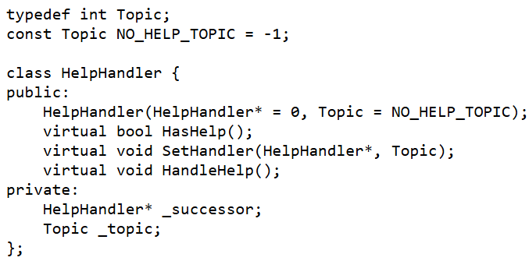
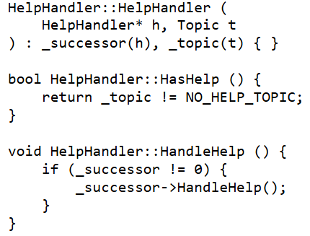
Abstract Handler
Defines interface for handling help request.
Initially help topic is empty (-1).
Subclasses override HandleHelp().
HasHelp is a convenience operation for checking whether there is an associated help topic.

Slide 20
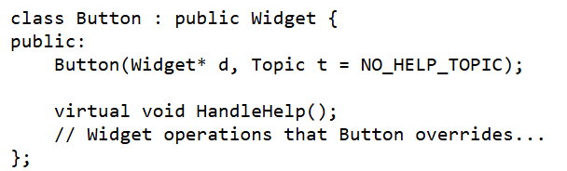
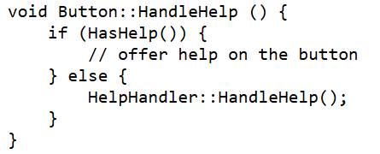
Handler Widget
class Widget : public HelpHandler {
protected: Widget(Widget* parent, Topic t = NO_HELP_TOPIC);
private: Widget* _parent;
};
Widget::Widget (Widget* w, Topic t) : HelpHandler(w, t) { _parent = w;}

Slide 21
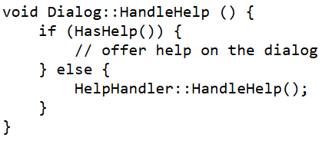

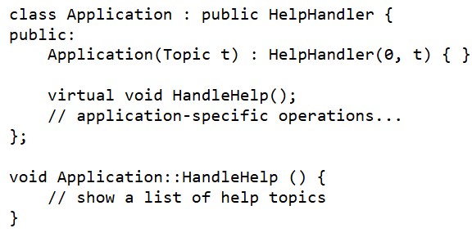
Concrete Handlers
Dialog will be the root.
Its next handler will be the Application
Application is not a Widget, but a HelpHandler.
When a help request propagates to this level, the application can supply information on the application in general, or it can offer a list of different help topics:

Slide 22
Setting up
const Topic PRINT_TOPIC = 1;
const Topic PAPER_ORIENTATION_TOPIC = 2;
const Topic APPLICATION_TOPIC = 3;
Application* application = new Application(APPLICATION_TOPIC);
Dialog* dialog = new Dialog(application, PRINT_TOPIC);
Button* button = new Button(dialog, PAPER_ORIENTATION_TOPIC);
….
button->HandleHelp();

Slide 23
Key points
The base Handler class maintains a “successor"
Each derived class implements its contribution for handling the request.
If the request needs to be "passed on", then the derived class "calls back" to the base class, which delegates to the “successor"
The client (or some third party) creates and links the chain
The client "launches and leaves" each request with the root of the chain.
  chain.sort(e); in the email example
Recursive delegation produces the illusion of magic.

Slide 24
Implementation issues
Request structure
  When request is data
    Handlers with the same method name to work with it
    Handlers with a set of method names, client tells which one and sends the request data
  When request is an action
    Encoding with string, enum, or int – not safe
    Command pattern (next)
Variation: pipe and filter
Using existing links or defining new links for successor (next)
Broken chain (next next)

Slide 25
CoR variations: Strict CoR
Strict CoR : First-Handler Model
Rule: Exactly one handler in the chain processes the request.
How it works: A handler checks if it can process the request.
  If YES, it handles it and stops the chain.
  If NO, it passes the request to its successor.
E.g. Context Sensitive Help
  It only calls HelpHandler::HandleHelp() in the else block .

Slide 26
CoR variations: Pipe-and-Filter
Rule: All (or many) handlers in the chain get a chance to process the request.
How it works: A handler performs its action (e.g., logging) and then unconditionally passes the request to the next handler to continue processing.
E.g. javax.servlet.Filter. A request (like AuthenticationFilter -> LoggingFilter) must pass through all of them.
  conceptually very similar to Decorator
we will use Strict CoR in this course.
Notes:
Pipe and filter is conceptually very similar to Decorator, as every object in the chain adds its behavior

Slide 27
CoR and Composite
Using existing links of Composite
Chain of Responsibility is often used in conjunction with Composite.
When a leaf component gets a request, it may pass it through the chain following the parent links of the components up to the root of the object tree.
  E.g. in a GUI leaf component (a button) passes the help request to its container (parent). It is passed up until someone handles it.

Slide 28
Composite with CoR
Participants?
Successor/parent
Component
Client
+operation()
+add(Component)
+remove(Component)
+getChild(int)
*
children
Leaf
Composite
+operation()
+operation()
+add(Component)
+remove(Component)
+getChild(int)
for all g in children g.operation()

Slide 29
CoR + Composite Example
Recall the context sensitive help
Make Widgets composite
:Button
:Dialog
:Application
handleHelp()
handleHelp()
Request will be passes along a chain
  1st object receives the help information request.
  Either handles it or pass it to the 2nd object
  Follow the chain until one object handles it

Slide 30
CoR with Composite
class Widget : public HelpHandler, Composite {
protected: Widget(Widget* parent, Topic t = NO_HELP_TOPIC);
};
Widget::Widget (Widget* w, Topic t) : HelpHandler(w, t) { _parent = w;}
class Composite{
protected: std::vector<Component *> children;
Component *_parent;
public:
virtual void add(Component *c) {children.push_back(c); c->parent=this};
virtual void remove(Component *c){children.remove(c)};
virtual Component *get(int i) const {
if (i<children.size()) return children[i]; return 0;}
};

Slide 31
Broken chain
What if programmer of a Handler does not pass control to the successor?
  When the handler cannot process the request, the request must follow the chain
  May omit to call super.handle(request)
  Abstract Handler does not implement the default behavior and handler omits successor.handle(request)
What is invariant of handling a request?
  Do it
  If not, pass it on
Implement the invariant once. Which pattern?

Slide 32
Broken chain – solution
Template Method to rescue.
abstract class Handler{
public final void handleReq(Request r){
bool isHandled=handleRequest(r);
if(successor!=null && !isHandled)
successor.handleReq(r);
}
public abstract boolean handleRequest(Request r);
private Handler successor=null;
public void setSuccessor(Handler h){
this.successor=h;}
}
Participants?

Slide 33
Consequences -1
Reduced coupling
  simplifies objects because they don’t have to know the chain’s structure and do not keep direct references to its members
Flexibility in assigning responsibilities
  allows to add or remove responsibilities dynamically by changing members or the chain order
OCP and Single Responsibility
  Handlers can be added/removed without altering existing code (OCP), and each handler focuses only on its processing logic (SRP).

Slide 34
Consequences -2
Some requests might not get handled
  execution of the request is not guaranteed.
  if may fall off the end of chain
Can be hard to observe the runtime characteristics and debug

Slide 35
Known use
java.awt used to be CoR but too many requests passed up in the hierarchy, so they switched to Observer pattern

Slide 36
Related patterns
Observer, Mediator and CoR
  Chain of Responsibility passes a request sequentially along a dynamic chain of potential receivers until one of them handles it.
  Mediator eliminates direct connections between senders and receivers, forcing them to communicate indirectly via a mediator object.
  Observer lets receivers dynamically subscribe to and unsubscribe from receiving requests.
Read https://gameprogrammingpatterns.com/observer.html#it-does-too-much-dynamic-allocation
Do you see the chain of responsibility?
Command (next) to implement requests as objects
Decorator

Slide 37
Related patterns
Composite together with CoR
  Parent links serve as successor
  The structural parent/child links within the Composite tree are reused to serve as the successor links in the Chain
  Difference: Composite is about part-whole hierarchy for recursive operations. CoR is about delegation for singular handling.
Command to implement requests as objects
Decorator vs CoR
  add responsibilities vs find a single handler that stops the chain

Slide 38
Decorator vs CoR
Decorator object diagram is almost the same as Chain of Responsibility object diagram
  Chain of handlers vs linked list of decorators
  However:
  Decorator has the real subject at the end,
  CoR all handlers are at the same level, no big object at the end

Slide 39
Decorator vs CoR -difference
With the decorator, all classes handle the request;
  Every decorator in the chain is executed
  Pipe-and-Filter is conceptually similar to Decorator
While for the chain of responsibility, exactly one of the classes in the chain handles the request (Strict CoR).
  This is a strict definition of the Responsibility concept in the GoF book. We will use strict CoR.
  One handler stops passing the request to the next one.
Notes:
The CoR handlers can execute arbitrary operations independently of each other. They can also stop passing the request further at any point. On the other hand, various Decorators can extend the object’s behavior while keeping it consistent with the base interface. In addition, decorators aren’t allowed to break the flow of the request.

Slide 40
Related Patterns –Request Handling
Pattern | How it Decouples (The Key Difference) | CoR vs. Alternative
Observer | Broadcasting/1-to-N: Receivers dynamically subscribe and unsubscribe. All subscribed receivers get the request/notification. | CoR passes the request sequentially for exclusive handling (Strict CoR)/ Observer broadcasts for shared notification. (request volume).
Command | Request Encapsulation: Encapsulates the request as an object, which is then passed to a chain or queue. | CoR is the dispatcher; Command is the payload. Command is often used with CoR to implement requests as objects:safer than encoding requests as strings.
Mediator | Centralized Hub: Eliminates direct connections between senders and receivers. | CoR is distributed and self-chaining. Mediator is centralized and explicit.

Slide 41
Handling many types of requests?
What if we have many types of requests?
Brittle Handlers:
  Handler interface becomes bloated with multiple methods:
    handleEmail(Email e), handlePayment(Payment p), etc.
OCP Violation:
  Adding a new request type (e.g., HelpRequest) means changing the abstract `Handler` and all concrete handlers.
Implicit Request:
  The request is just passive data (like Email).
  It has no behavior and cannot carry complex logic.

Slide 42
CoR with Command
Command is the “request”
// A concrete command
public class AuthCommand implements Command {
private User user;
public AuthCommand(User u) { this.user = u; }
public void execute() {
System.out.println("Authenticating " + user.name); // ... auth logic
}
}
public class LogCommand implements Command {
private String message;
public LogCommand(String msg) { this.message = msg; }
public void execute() {
System.out.println("LOG: " + message); // ... logging logic ...
}
}

Slide 43
CoR with Command
Handler executes the command
// A concrete command
public class AuthCommand
implements Command {
private User user;
public AuthCommand(User u) {
this.user = u; }
public void execute() {
// ... auth logic
}
}
public class AuthHandler extends Handler {
protected boolean
canHandle (Command cmd) {
// only handles AuthCommands
if (cmd instanceof AuthCommand) {
cmd.execute();
return true; // Stop the chain
}
return false; // Pass to successor
}
}

Slide 44
public class Application {
public static void main(String[] args) {
// 1. Build the chain
Handler auth = new AuthHandler();
Handler log = new LogHandler();
auth.setSuccessor(log);
// auth -> log -> null
// 2. Create command objects
Command login = new AuthCommand(new User("grad_student"));
Command greeting = new LogCommand("User logged in");
Command invalid = new PaymentCommand(200.0); // Not shown

Slide 45
// 3. Send commands to the chain root
System.out.println("--- Sending Auth Command ---");
auth.handle(login);
// Output: "Authenticating grad_student"
System.out.println("--- Sending Log Command ---");
auth.handle(greeting);
// Output: "LOG: User logged in"
System.out.println("--- Sending Invalid Command ---");
auth.handle(invalid);
// Output: (nothing)
}
}

Slide 46
Decouple sender and handler
Observer
Command
mediator
Chain of Responsibility

Slide 47
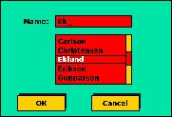
Example: GUI coordination
A From dialog window
Multiple dependencies
  When an item of list is selected,
    the selection will be displayed on the entry field
    Ok button will be enabled, etc…
  Change in the FilterPanel triggers updates in
    ProductList, Pagination, and SummaryLabel

Slide 48
Motivation
It is hard to keep track which rules reside in which objects, and how objects should relate to each other
Chaotic many-to-many dependency
If the objects interact with each other directly, the system components are tightly coupled with each other making higher maintainability cost and not hard to extend

Slide 49
Could CoR solve it?
coordinate complex updates between a FilterPanel, SearchBox, and ProductList.
GUI Needs Simultaneous Coordination
  A change in the FilterPanel must trigger updates in the ProductList, Pagination, and SummaryLabel at the same time.
Notes:
CoR and Observer fail, such as a modern, complex GUI Form or a rich web application with interdependent components (e.g., filter panel, data grid, and summary statistics).
The Setup: When the user changes a filter (Component A), three other components (B, C, D) must update.
Why Observer Fails: If A broadcasts, B, C, and D receive the notification, but often B needs to tell C something after it updates, creating a spaghetti code mess of observers observing each other.
Why CoR Fails: The components don't form a sequential chain; they all need to be managed simultaneously.

Slide 50
Could CoR solve it?
CoR is for Sequential Delegation
  If the filter panel became the head of the chain, the request would hit the SearchBox first.
  The SearchBox would have no reason to approve or stop the request, so it would pass it down, adding unnecessary overhead.
CoR fails: problem is not about giving one object a chance to handle the request;
It is about managing a complex fan-out of required actions triggered by a single event.
Notes:
CoR and Observer fail, such as a modern, complex GUI Form or a rich web application with interdependent components (e.g., filter panel, data grid, and summary statistics).
The Setup: When the user changes a filter (Component A), three other components (B, C, D) must update.
Why Observer Fails: If A broadcasts, B, C, and D receive the notification, but often B needs to tell C something after it updates, creating a spaghetti code mess of observers observing each other.
Why CoR Fails: The components don't form a sequential chain; they all need to be managed simultaneously.

Slide 51
Observer?
Observer eliminates the direct link between a Subject and its observers, but in complex GUIs …
1) Chaotic Many-to-Many Dependencies
  Everyone subscribes to everyone
  a tangled web of subscriptions.
2) Notification Cascade
  If the FilterPanel (Subject) broadcasts a change, the ProductList, SummaryLabel, and Pagination all receive it.
  If the ProductList then changes the page count, it has to notify other observers, which can trigger circular or cascading updates.
    circular updates: A notifies B, B's update notifies A, etc..

Slide 52
Observer?
3) Low cohesion in Observers
public void update(Subject changedSubject) {
// I have to figure out WHO notified me...
if (changedSubject == filterPanel) {
// ...and then run the specific logic
runFilterLogic();
} else if (changedSubject == searchBox) {
runSearchLogic();
} else if (changedSubject == pagination) {
runPaginationLogic();
}
// This is complex, brittle, and violates SRP!
}
Notes:
The component is no longer responsible only for itself; it is responsible for coordinating the behavior of all its peers. (SRP Violation).

Slide 53
Observer?
Notification vs. Coordination
Observer: 1-to-N broadcasting.
  "Does anyone need to know I changed?“
GUI Problem: COORDINATION
  N-to-N interaction.
  "When this component changes, what complex logic must I execute to orchestrate all other components?“
Observer fails because it distributes the coordination logic, leading to chaos. We need a pattern that centralizes it

Slide 54
Motivation
Chaotic many-to-many dependency
Solution: Mediate the communication
Centralize complex communication and control between related objects
  colleagues tell the mediator when their state changes
  they respond to requests from the mediator

Slide 55
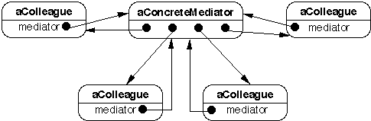
Mediator Structure

Slide 56
Mediator Pattern
A Form dialog window
A mediator: FormDialogDirector
  control and coordinate the interactions
  objects only know the Mediator
    reduced number of interactions
Commonly used to coordinate related GUI components
See https://refactoring.guru/design-patterns/mediator/java/example

Slide 57
Sequence Diagram
MEDIATOR
:Client
:FormDialogDirector
:ListBox
:EntryField
:Button
showDialog()
widgetChanged()
getSelection()
setText()
enableButton()
Notes:
The list box tells its director that it's changed.
The director gets the selection from the list box.
The director passes the selection to the entry field.
Now that the entry field contains some text, the director enables button(s) for initiating an action

Slide 58
Mediator Pattern
A mediator is responsible for controlling and coordinating the interactions of a group of objects
Putting the logic in one mediator object to manage state changes of others
  instead of distributing the logic over the other objects
  trading complexity of interaction for complexity of mediator
More cohesive implementation of the logic
Decreased coupling between the other objects

Slide 59
Mediator Pattern
Intent: Define an object that encapsulates how a set of objects interact.
  Mediator promotes loose coupling by keeping objects from referring to each other explicitly, and it lets you vary their interaction independently

Slide 60
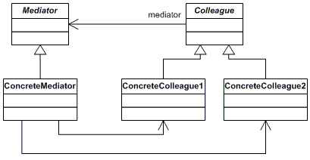
Mediator Structure
As long as the colleague works with its mediator via the generic interface, we can link it with a different implementation of the mediator.

Slide 61
Participants
Mediator interface: defines the interface between the objects.
  In most cases, a single method for receiving notifications from components is sufficient
ConcreteMediator: stores references to colleagues. Implements the communication protocol and coordinates colleagues
Colleague: has reference to the mediator. Communicates with its mediator whenever it would have otherwise communicated with another colleague.
  When the colleague works with its mediator via the generic interface, we can link it with a different implementation of the mediator.
Notes:
. Read https://refactoring.guru/design-patterns/mediator

Slide 62
Centralized Control
Benefits
  colleagues focus on their operations
  interaction protocol becomes visible
  when the rule changes only change the mediator
  when a new colleague is added, change only the mediator
  participants are not aware of the existence of other objects
Drawback
  overkill for simple communication

Slide 63
Applicability –when…
A set of objects communicate in a well-defined but complex ways. The interdependencies are unstructured and difficult to understand.
It is hard to change some of the classes due to tight coupling with other classes
  Also, when some objects are hard to reuse because it refers to and communicates with many other objects
A behavior that's distributed between several classes should be customizable without a lot of subclassing
  Each participant’s subclass vs Mediator subclass
Notes:
Use the Mediator when you find yourself creating tons of component subclasses just to reuse some basic behavior in various contexts.
Mediator (refactoring.guru)https://refactoring.guru/design-patterns/mediator

Slide 64
Example 1: Air Traffic
There are multiple airplanes that need to communicate and coordinate their movements to avoid collisions and ensure safe takeoffs and landings.
  Direct communication between airplanes is error-prone
  Collision risk when the status of all airplanes in the air space is unknown
Source: https://www.geeksforgeeks.org/mediator-design-pattern/

Slide 65
Example: Air Traffic
ControlTower
+requestTakeoff
+requestLanging
Airplane
CommercialPlane
+requestTakeoff
+requestLanding
+notifyController
AirportController
-airplanes

Slide 66
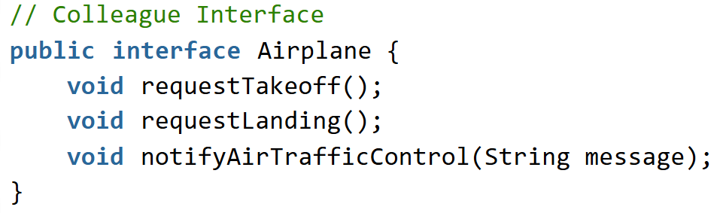
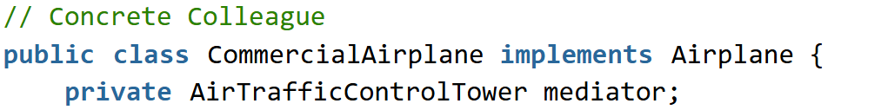


Implementing Colleagues
https://www.geeksforgeeks.org/mediator-design-pattern/
}
}
}
public void notifyAirTrafficControl(String message) {
System.out.println("Commercial Airplane: " + message);}
Notes:
public void notifyAirTrafficControl(String message) {
System.out.println("Commercial Airplane: " + message);
}

Slide 67
Implementing Mediator
public interface ControlTower { // Mediator Interface
void requestTakeoff(Airplane airplane);
void requestLanding(Airplane airplane);
}
// Concrete Mediator
public class AirportController implements ControlTower {
public void requestTakeoff(Airplane airplane) {
// Logic for coordinating takeoff
airplane.notifyAirTrafficControl("Requesting takeoff clearance.");
}
public void requestLanding(Airplane airplane) {
// Logic for coordinating landing
airplane.notifyAirTrafficControl("Requesting landing clearance.") }
private List<Airplanes>;
}

Slide 68
Implementation issues-1
Colleague-Mediator communication
Choice1: Mediator observing colleagues (subjects)
  Each time a change is made in the state of a colleague object, the mediator gets notified
  Then, mediator notifies all other colleague objects.
Choice 2: When communicating with the mediator, a colleague passes itself as an argument, allowing the mediator to identify the sender.
  Airplane example
Message queue in mediator

Slide 69
Implementation issues -2
If colleagues are going to use only one mediator, no need to define Abstract Mediator.
  The definition of an abstract Mediator is required only if the colleagues needs to work with different mediators.
Complexity of the mediator could be a problem when there are a lot of participants
When not all colleagues are of the same abstract type
  Mediator becomes tightly coupled
  Mediator logic becomes complex
  Adapter?
Notes:
Use adapter when they do not sah

Slide 70
Back to Example 1: DialogDirector
When an item in the list box is selected
The list box tells its director that it's changed.
The director gets the selection from the list box.
The director passes the selection to the entry field.
Now that the entry field contains some text, the director enables button(s) for initiating an action

Slide 71
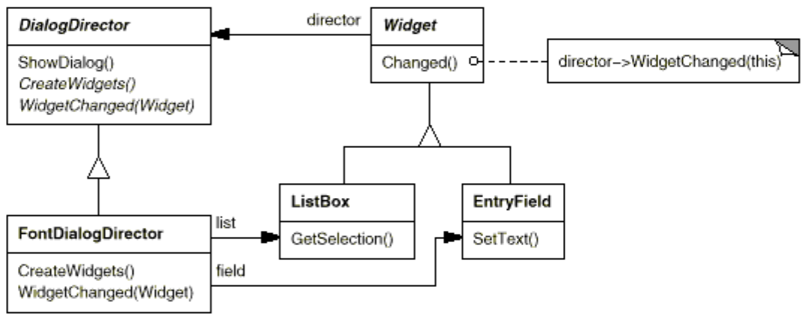
Example 1: DialogDirector

Slide 72
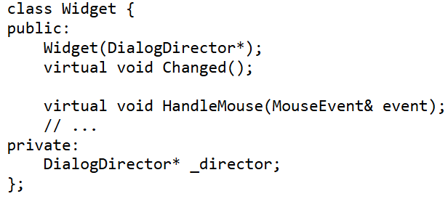

Example1: Colleagues

Slide 73
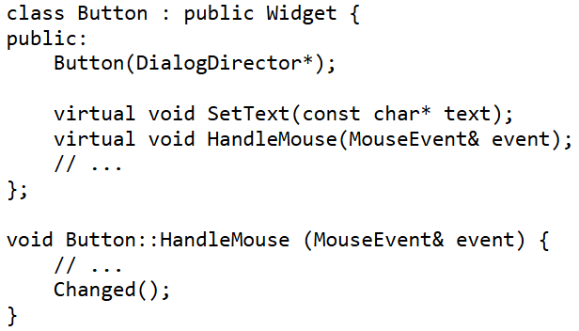
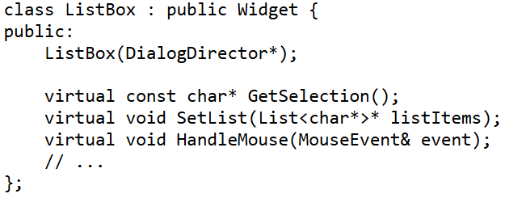
Concrete Colleagues

Slide 74
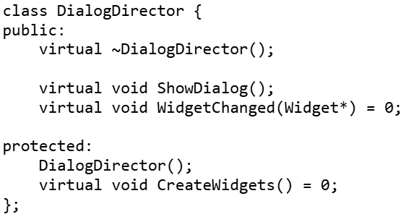
Example1: Mediator
Do I see a Factory Method?

Slide 75
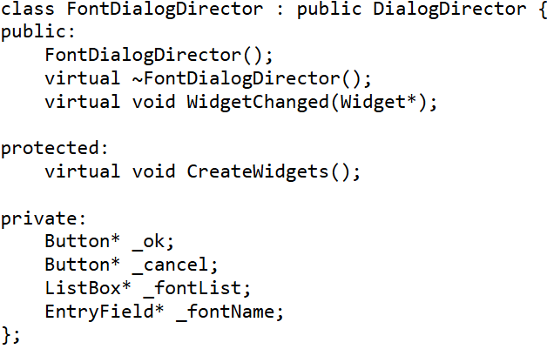
Example1:Concrete Mediator

Slide 76
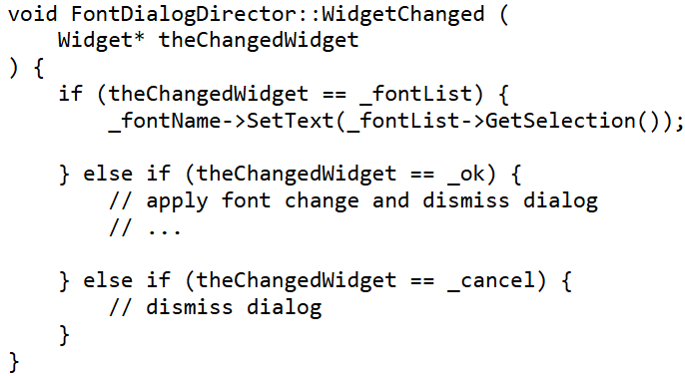
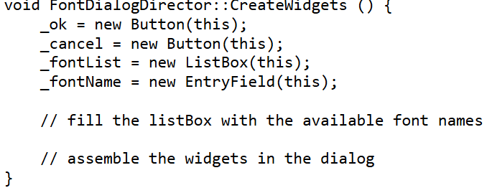
Example1:Concrete Mediator

Slide 77
Consequences: Benefits
Improves comprehension of the system by centralized control logic
  Hence simplifies maintenance
  Also, when this logic need to be extended only the mediator class need to be extended.
The colleague classes are totally decoupled.
  Adding a new colleague class is very easy due to this decoupling level.
  increases reusability of the colleagues of the mediator by decoupling them from the system
Thus, increase cohesion and reduce coupling
Notes:
Eliminates direct connections between senders and receivers

Slide 78
Consequences -2
The colleague objects must communicate only with the mediator objects.
  Reduction from many-to-many to one-to-many and many-to-one.
  It simplifies object protocols. A mediator replaces many-to-many interactions with one-to-many interactions between the mediator and its colleagues. One-to-many relationships are easier to understand, maintain, and extend.
Reuse participants easily

Slide 79
Consequences-3
Limits subclassing. A mediator localizes behavior that otherwise would be distributed among several objects. Changing this behavior requires subclassing Mediator only; Colleague classes can be reused as is.
Abstracts how objects cooperate. Making mediation an independent concept and encapsulating it in an object lets you focus on how objects interact apart from their individual behavior. That can help clarify how objects interact in a system.

Slide 80
Consequences - Drawbacks
Trades complexity of interaction for complexity in the mediator.
  Because a mediator encapsulates protocols, it can become more complex than any individual colleague.
  This can make the mediator itself a monolith that's hard to maintain.
Overkill for simple interaction
Without a proper design, the mediator itself becomes overly complex
  Do not add extra responsibilities to mediator
  E.g. DialogDirector class should not contain code which is not a part of the coordination.

Slide 81
Mediator – Known uses
java.awt.Container: This class acts as a mediator between components and the specific layout manager
java.util.concurrent.Executor: This interface is a mediator between a bunch of tasks that need to be run and a bunch of threads in which the tasks are run1.

Slide 82
Mediator vs Façade
Both abstract functionality of existing classes.
Mediator abstracts/centralizes arbitrary communication between colleague objects
  routinely "adds value",
  Known and referenced by the colleague objects
    i.e. it defines a multidirectional protocol
Facade defines a simpler interface to a subsystem,
  doesn't add new functionality
  not known by the subsystem classes

Slide 83
Observer vs Mediator
Mediator and Observer are competing patterns.
communication:
  Observer distributes communication by introducing "observer" and "subject" objects
  Mediator object encapsulates the communication between other objects.
Observer is one-to-many, Mediator is many-to-many
They may work together
  Mediator observing colleagues if something changed
  Colleagues may subscribe to mediator

